Slide 1
Kotlin + Spring Boot ： 下一代 Java 服务端开发
东海陈光剑

Slide 2
第1讲 Spring Boot 快速开始

Slide 3
Spring Boot 是什么?
Spring Boot 提供了一种极简的方式来创建、开发项目：
stand-alone
Embed Tomcat, Jetty or Undertow directly (no need to deploy WAR files)
提供自用'starter' POMs to simplify configuration
production-grade（metrics, health checks，etc）
Spring based Applications
that you can "just run".

Slide 4
Spring 历史回顾: J2EE Development without EJB
降低开发成本
缩短开发周期
提高可维护性和运行效率
响应式编程WebFlux
Kotlin DSL
Spring1.0
Spring 2.0
Spring 2.5
Spring 3.0
Spring 4.0
Spring 5.0
依赖注入
声明式事务
自定义 XML 配置
@Component
@Autowired
面向注解的
Spring MVC
@Enable 注解
JavaConfig
@Conditional
条件化配置
Spring Boot 自动配置

Slide 5
Spring 的问题： Why Spring Boot ?
Spring Boot Starters
XML
基于XML的DSL
注解
基于JavaConfig
庞大的jar 包库的版本兼容性
配置步骤复杂
构建部署费事
一堆样板化的配置：
DataSource、
EntityManagerFactory、
TransactionManager
ViewResolver
MessageResource
TemplateEngine
…
自动配置

Slide 6
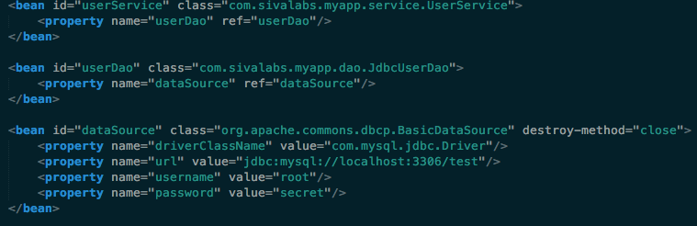
XML based configuration

Slide 7
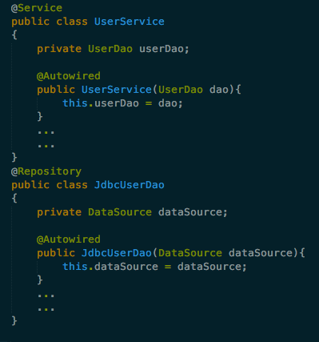
Annotation based configuration

Slide 8
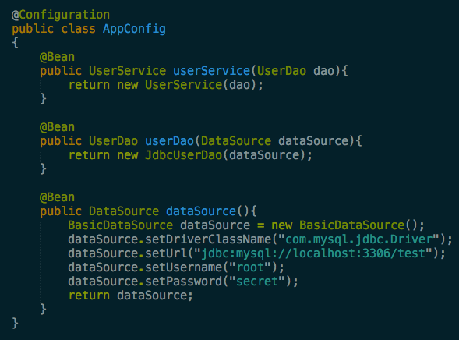
JavaConfig based configuration

Slide 9
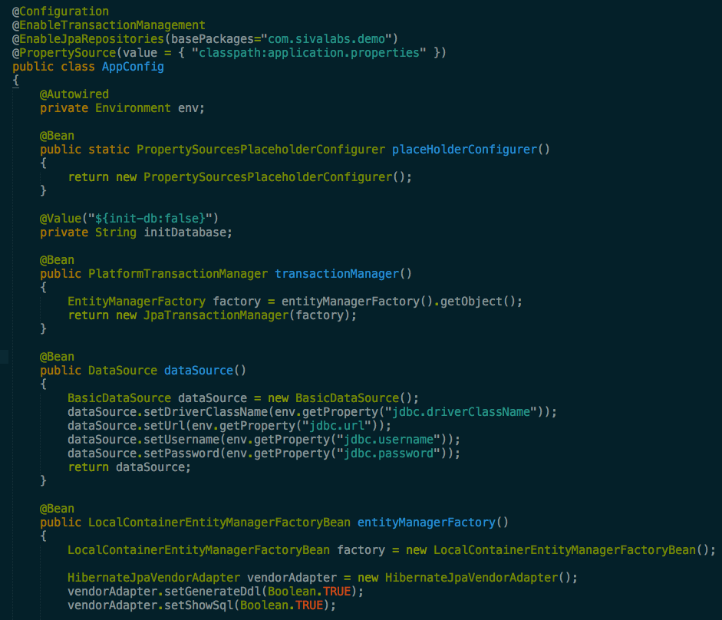
Configure Service/DAO layer beans using JavaConfig

Slide 10
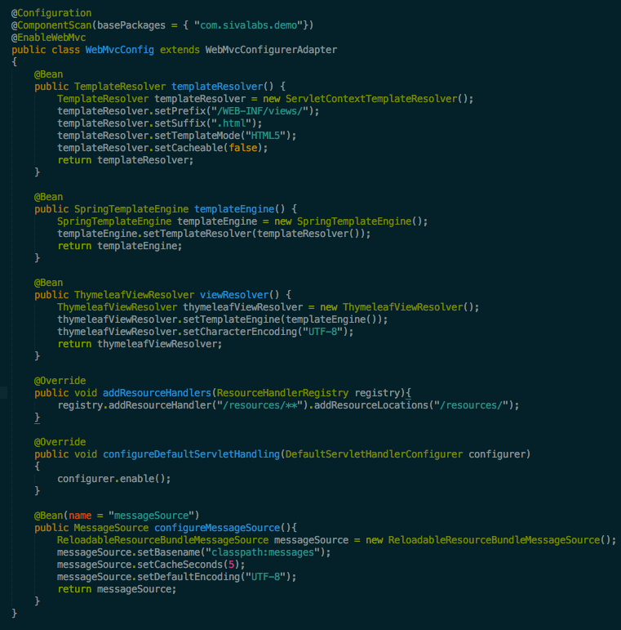
Configure Spring MVC web layer beans using JavaConfig

Slide 11
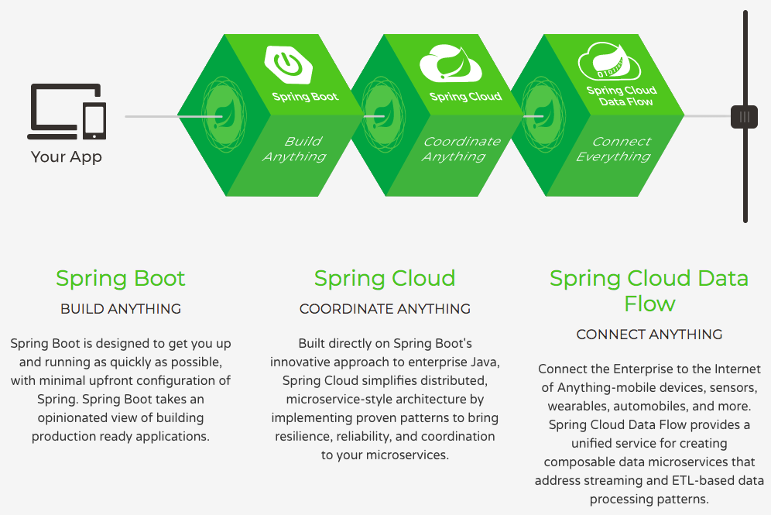
Spring: the source for modern java

Slide 12
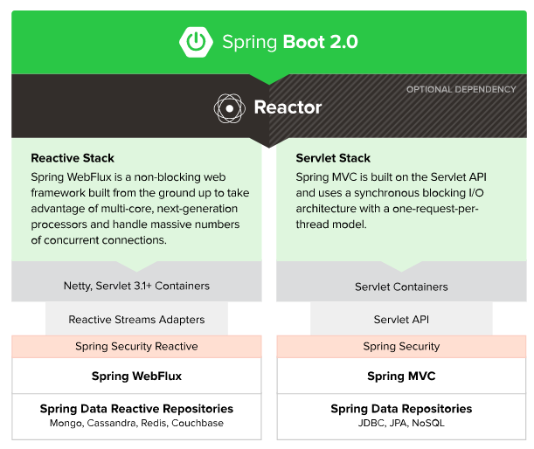
Spring Framework 5 生态

Slide 13
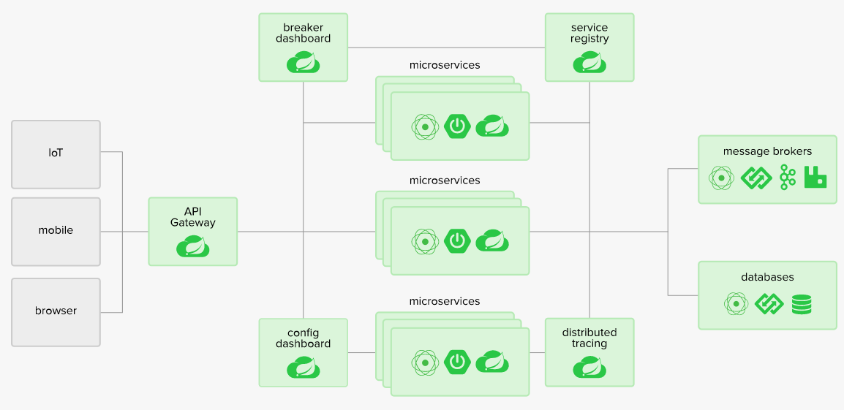
微服务 Microservice

Slide 14
Hello World
$ spring init \
> -d=web \
> -b=2.0.0.M6 \
> -a=helloword \
> -g=com.ksb \
> -j=1.8 \
> -l=kotlin \
> --build=gradle \
> -n=helloword \
> -p=jar \
> -x
Using service at https://start.spring.io
Project extracted to '/Users/jack/ksb'
$ tree
.
├── build.gradle
├── gradle
│ └── wrapper
│ ├── gradle-wrapper.jar
│ └── gradle-wrapper.properties
├── gradlew
├── gradlew.bat
└── src
├── main
│ ├── kotlin
│ │ └── com
│ │ └── ksb
│ │ └── helloword
│ │ └── HellowordApplication.kt
│ └── resources
│ ├── application.properties
│ ├── static
│ └── templates
└── test
└── kotlin
└── com
└── ksb
└── helloword
└── HellowordApplicationTests.kt
16 directories, 8 files
$ gradle bootRun
http://repo.spring.io/release/org/springframework/boot/spring-boot-cli/

Slide 15
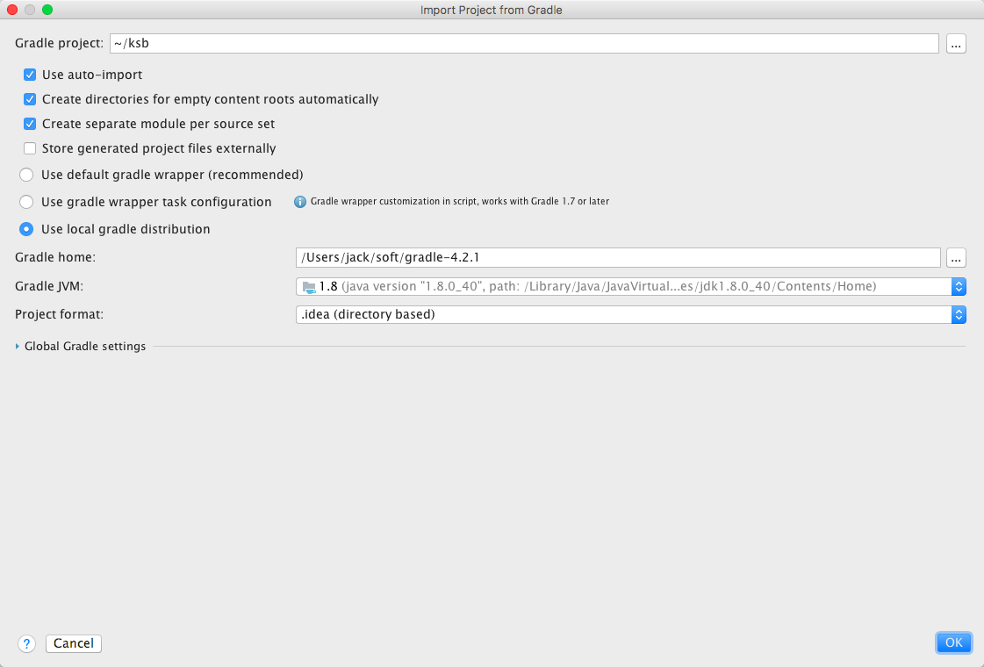

Slide 16
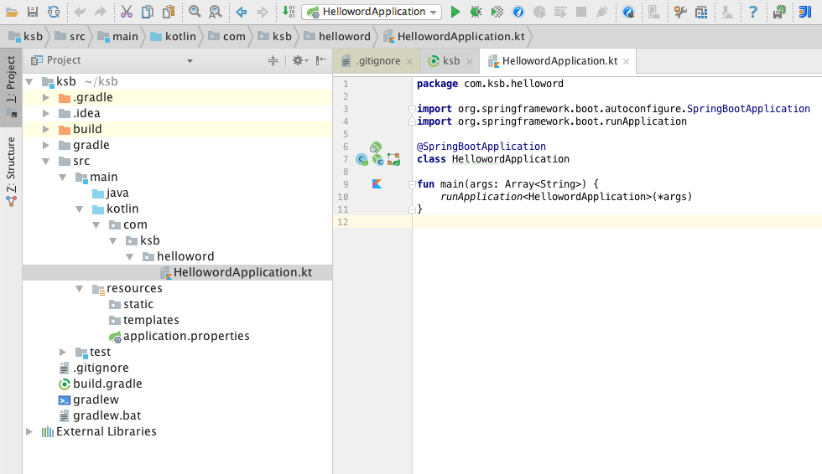

Slide 17
Spring Boot 应用的入口类
main方法
package com.ksb.helloword import org.springframework.boot.autoconfigure.SpringBootApplication import org.springframework.boot.runApplication @SpringBootApplication class HellowordApplication fun main(args: Array<String>) { runApplication<HellowordApplication>(*args) }
@SpringBootApplication =
@Configuraiton +
@EnableAutoConfiguration +
@ComponentScan
@Target(ElementType.TYPE) @Retention(RetentionPolicy.RUNTIME) @Documented @Inherited @SpringBootConfiguration @EnableAutoConfiguration @ComponentScan(excludeFilters = { @Filter(type = FilterType.CUSTOM, classes = TypeExcludeFilter.class), @Filter(type = FilterType.CUSTOM, classes = AutoConfigurationExcludeFilter.class) }) public @interface SpringBootApplication {

Slide 18
Spring Boot CLI
Examples:
To list all the capabilities of the service:
$ spring init --list
To creates a default project:
$ spring init
To create a web my-app.zip:
$ spring init -d=web my-app.zip
To create a web/data-jpa gradle project unpacked:
$ spring init -d=web,jpa --build=gradle my-dir

Slide 19
spring init 命令参数说明
$ spring help init
spring init - Initialize a new project using Spring Initializr (start.spring.io)
usage: spring init [options] [location]
Option Description
------ -----------
-a, --artifactId Project coordinates; infer archive
name (for example 'test')
-b, --boot-version Spring Boot version (for example
'1.2.0.RELEASE')
--build Build system to use (for example
'maven' or 'gradle') (default: maven)
-d, --dependencies Comma-separated list of dependency
identifiers to include in the
generated project
--description Project description
-f, --force Force overwrite of existing files
--format Format of the generated content (for
example 'build' for a build file,
'project' for a project archive)
(default: project)
-g, --groupId Project coordinates (for example 'org.
test')
-j, --java-version Language level (for example '1.8')
-l, --language Programming language (for example
'java')
-n, --name Project name; infer application name
-p, --packaging Project packaging (for example 'jar')
--package-name Package name
-t, --type Project type. Not normally needed if
you use --build and/or --format.
Check the capabilities of the
service (--list) for more details
--target URL of the service to use (default:
https://start.spring.io)
-v, --version Project version (for example '0.0.1-
SNAPSHOT')
-x, --extract Extract the project archive. Inferred
if a location is specified without
an extension
-d（dependencies 依赖包） -g（Group Id） -a（Artifact Id） --package-name（Package name） --name（Project name） -x（Extract compatible archives
$ spring help init
spring init
-d=web,data-jpa
-g=com.ksb
-a=helloworld
-b=2.0.0.M6
--build=gradle
-l=kotlin
-j=1.8
--package-name=com.ksb
--name=helloworld
-x

Slide 20
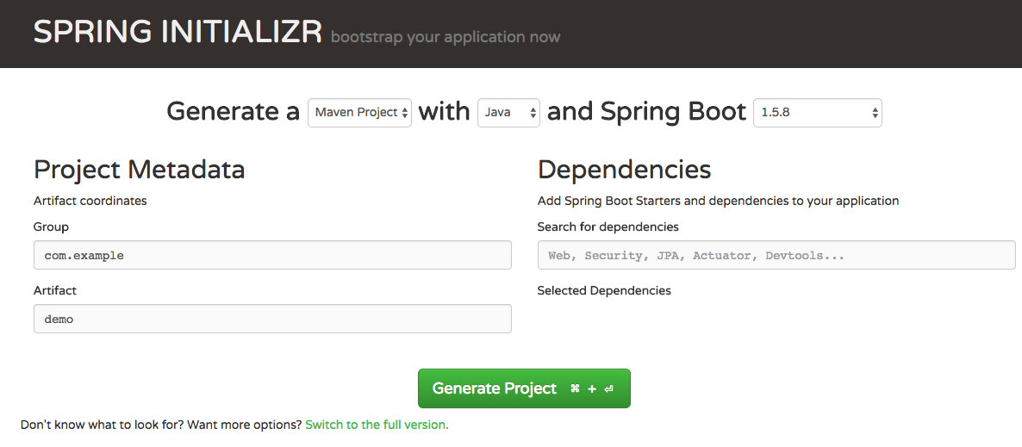
A quick taste of Spring Boot： Quick Start Hello World
使用 Spring Initializr 几秒钟内快速创建 Spring Boot 项目
http://start.spring.io/

Slide 21
小结
Spring Boot 解决使用 Spring 框架过程中配置复杂的问题
AutoConfiguraiton

